Slide 1
ADULT INCOME DATA REPORT

Slide 2



What FACTORS AFFECT AN ADULT’S INCOME?
AGE
EDUCATION LEVEL
HOURS WORKED

Slide 3
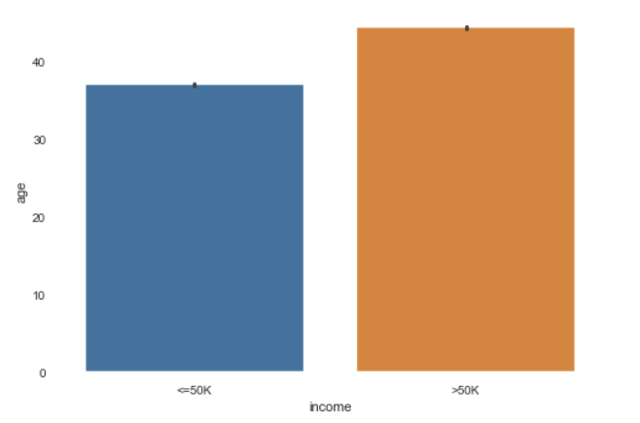
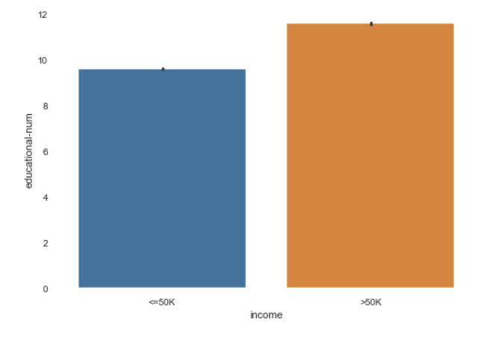
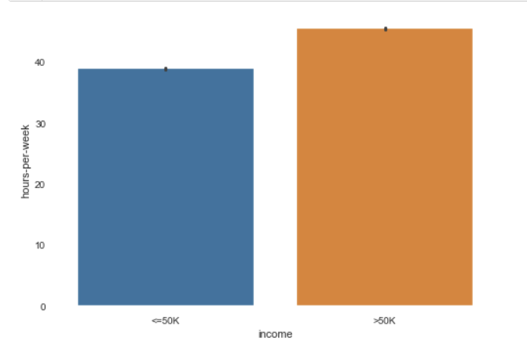
The higher the age, education level, and hours per week, the higher your income

Slide 4

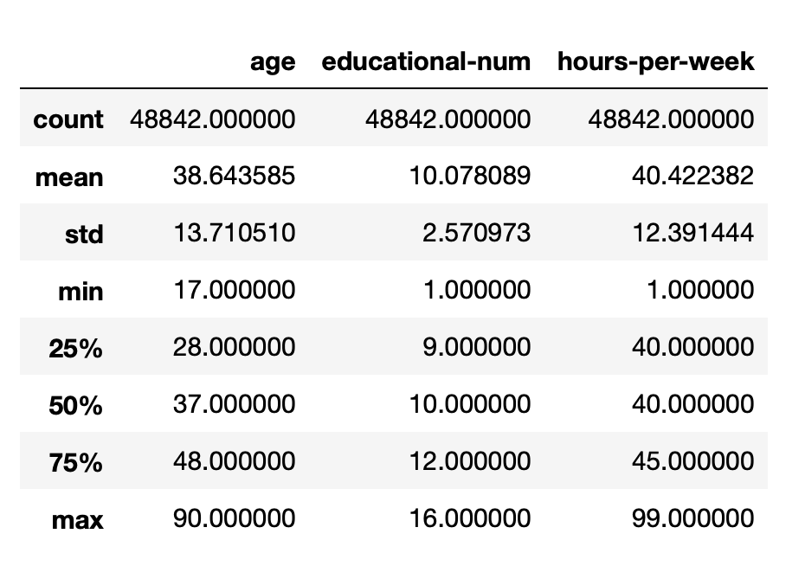
The average adult
39 years old
10 years of education
40 hours work week

Slide 5
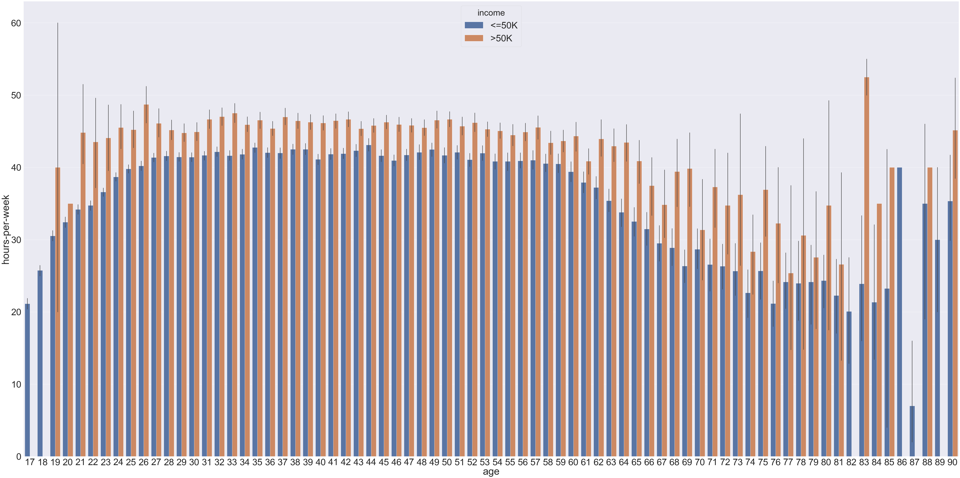

Slide 6
FACTOIDS
Most ADULTS EARN more than 50 thousand dollars.
ADULTS EARNING 50 THOUSAND DOLLARS OR LESS HAS AN INCREASING TREND FROM 19 to 29 years old.
INCOME OF ALL ADULTS START TO DECLINE AT AGE 61.
Oldest person working is 90 while the youngest is 17.
The age and Hours work per week vary greatly.

